Slide 1



Slide 2
Contents
1
Revision
2
Logarithms
3
Selection Sort algorithm
4
Bubble Sort algorithm

Slide 3
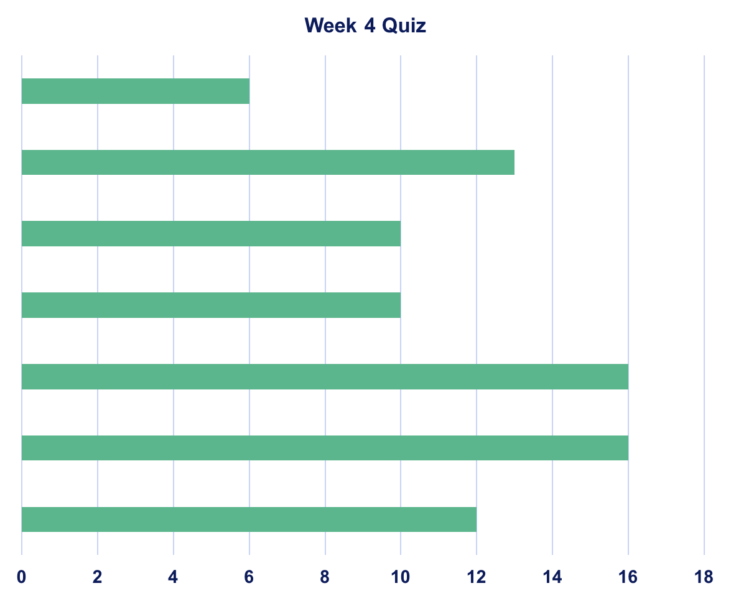
Week 4 Lab Feedback
100
80-99
70-79
60-69
50-59
40-49
<40

Slide 4
Revision
An array is a finite, ordered set of homogeneous elements.
Finite: there is a specific number of elements in the array
Ordered: elements of the array are arranged so that there is a zeroth, first, second ..
Homogeneous: all elements in the array must be of the same type

Slide 5

Big O
Describes the performance or complexity of an algorithm.
Describes the worst-case scenario - execution time required or the space used by an algorithm.

Slide 6
Big O
O(1)
O(n)
O(n²)
….
http://rob-bell.net/2009/06/a-beginners-guide-to-big-o-notation/

Slide 7
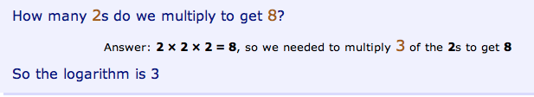

Introduction to Logarithms
http://www.mathsisfun.com/algebra/logarithms.html

Slide 8



Answer the following ….

Slide 9
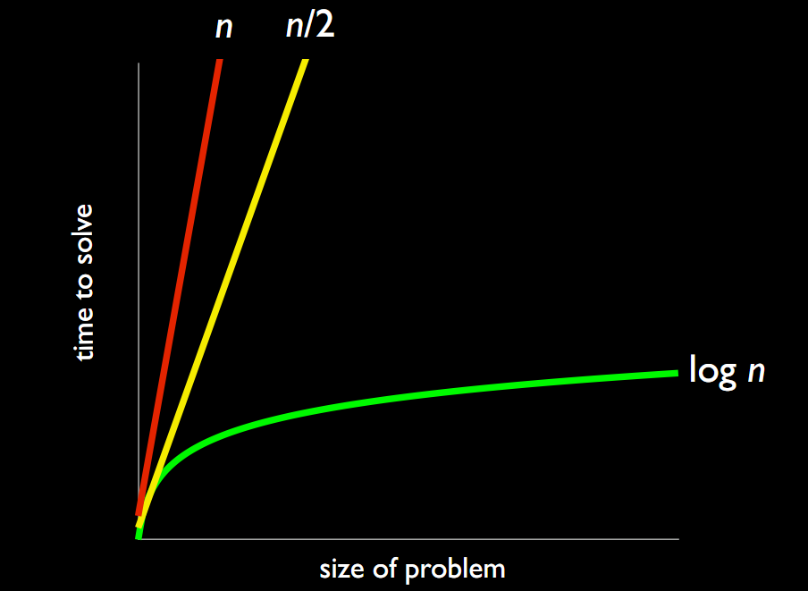
Where do I need log?

Slide 10
Selection Sort
How can this be sorted using Selection Sort?
4
2
6
8
1
3
7
5

Slide 11
Selection Sort
What are the steps?
Find the smallest unsorted number
Swap it into lowest unsorted position
Revisit 1&2 until the entire array is sorted
4
2
6
8
1
3
7
5
1
2
6
8
4
3
7
5

Slide 12
Selection Sort
How efficient is it?
What does that mean?
O(n²)

Slide 13
Selection Sort
SELECTION SORT
Best | Average | Worst
Ω(n²) | Θ(n²) | O(n²)
Array

Slide 14
Selection Sort: The algorithm
If the performance of selection sort is O(n²), this insinuates that there are two loops:
Loop 1
Loop 2
End Loop 2
End Loop 1
n * n

Slide 15
Selection Sort: The algorithm
What does Loop 2 do?
What does Loop 1 do?
Loop 1
Loop 2
End Loop 2
End Loop 1

Slide 16
Selection Sort: The algorithm
What does Loop 2 do?
  Finds the lowest number
The new lowest number is then swapped

Slide 17
Selection Sort: The algorithm
What does Loop 1 do?
  Loop 2 to find the lowest number
  Swap numbers
Repeats this n times

Slide 18
Selection Sort: The algorithm
Can we refine this description?
  Repeat Loop 1 N-1 times
    Repeat Loop 2 until
    Find smallest number
    Swap with current number
    End Loop 1
Now write the pseudo code for this algorithm

Slide 19
Selection Sort: The algorithm
Input: An array A storing N items
Output: A sorted in ascending order

Slide 20
Algorithm Selection_Sort (A, N):
for i = 0 to i < N-1 do
min = i
for j = i+1 to j < N do
if A[j] < A[min] then
min = j
temp = A[min]
A[min] = A[i]
A[i] = temp
End for
Find the smallest
Make the swap
Could I make this more efficient?

Slide 21
Bubble Sort
How can this be sorted using bubble sort?
4
2
6
8
1
3
7
5

Slide 22
Bubble Sort
What are the steps?
Compare first 2 numbers
Swap, if necessary, into chronological order
Compare 2nd number of Step 2 and next number. Revisit 2 & 3 until completely sorted.
4
2
6
8
1
3
7
5

Slide 23
Bubble Sort
How efficient is it?
Why?
O(n²)

Slide 24
Bubble Sort
BUBBLE SORT
Best | Average | Worst
Ω(n) | Θ(n²) | O(n²)
Array

Slide 25
Bubble Sort: The algorithm
If the performance of bubble sort is O(n²), this insinuates that there are two loops (like selection sort):
Loop 1
Loop 2
End Loop 2
End Loop 1

Slide 26
Bubble Sort: The algorithm
What does Loop 2 do?
What does Loop 1 do?
Loop 1
Loop 2
End Loop 2
End Loop 1

Slide 27
Bubble Sort: The algorithm
What does Loop 2 do?
  Swaps numbers if necessary

Slide 28
Bubble Sort: The algorithm
What does Loop 1 do?
  Loop 2 to swap numbers if necessary
Repeats this n times

Slide 29
Bubble Sort: The algorithm
Can we refine this description?
  Repeat Loop 1 N -1 times
    Repeat Loop 2 N -1 times
    Swap number if necessary
    End Loop 1
Now write the pseudo code for this algorithm

Slide 30
Bubble Sort: The algorithm
Input: An array A storing N items
Output: A sorted in ascending order

Slide 31
Algorithm Bubble_Sort (A, N):
for i = 0 to i < N-1 do
for j = 0 to j < N-1 do
if A[j] > A[j+1]
temp = A[j]
A[j] = A[j+1]
A[j+1] = temp
End if
End for
End for
Make the swap

Slide 32
Recap
Selection sort algorithm:
  What are the 3 steps?
  What is the worse case scenario?
  How many loops are in this algorithm?
  What are they for?

Slide 33
Recap
Bubble sort algorithm:
  What are the 3 steps?
  What is the worse case scenario?
  How many loops are in this algorithm?
  What are they for?

Slide 34
Thank You !

